Slide 1
NSU WEB TIME APPROVAL
Step by Step Guide to Approving Electronic Timesheets
Approvers

Slide 2
Approver Responsibilities
Review & Verify
Review & verify all hours entered and/or leave taken to ensure any necessary corrections are made prior to approving time.
*Note – Any leave taken and/or comp/overtime entered on the employee's web timesheet should have an approved corresponding document (including the supervisor’s signature) to match.
Return for Correction (if needed)
Notify the employee when a web timesheet is returned for corrections.
Documents to Payroll
Once all time has been approved via the web, all time entry documentation should be forwarded to the Payroll department. This includes all Request for Leave documents (including any backup documentation) and all Compensatory/Overtime Earned documents.
*Note – All Graduate Assistant, Students & Wages of Labor documents are kept in the department’s file for 5 years.
Approve the employee’s web time entry for every pay period.
Approve

Slide 3
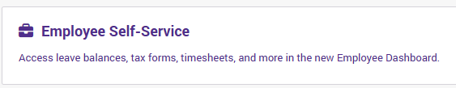
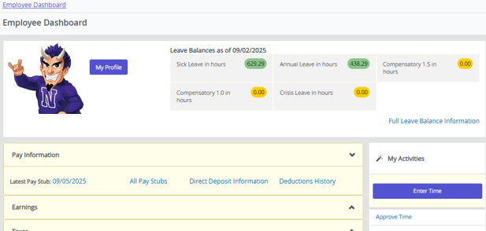
Access Web Timesheets to Approve
Log into myNSU.
Choose Employee Self-Service to access the Employee Dashboard.
Click “Approve Time” in the My Activities section to view & approve employee timesheets.

Slide 4
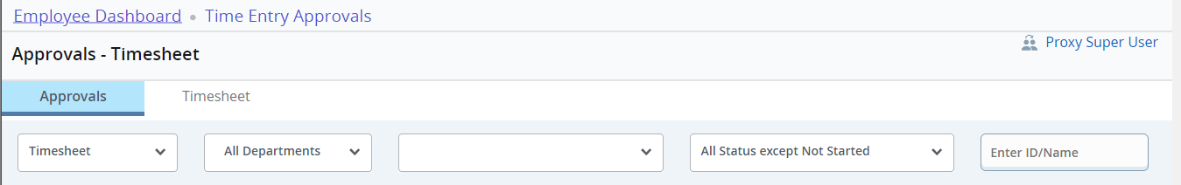
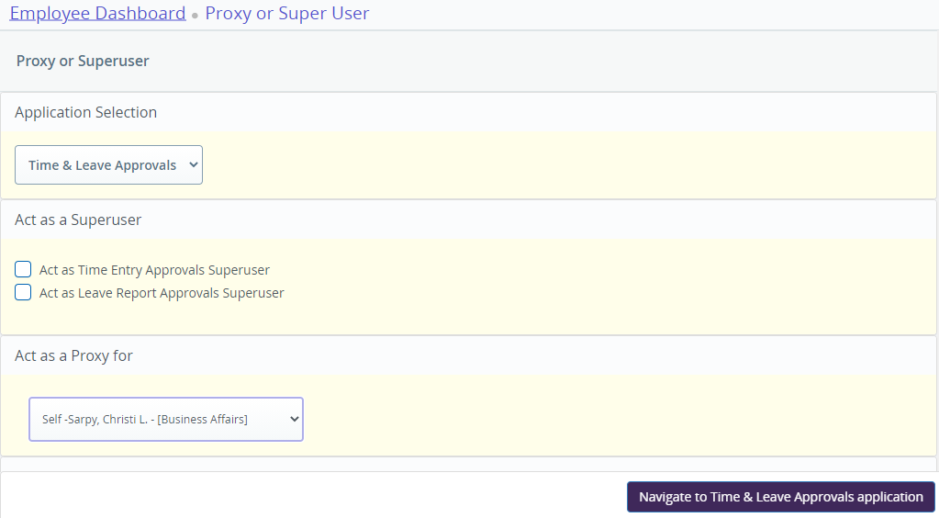
Time Entry Approvals
(Proxy Approvers ONLY)
Click ‘Proxy Super User’
Choose the following:
Application Selection –
Time & Leave Approvals
Act as a Proxy for –
Choose the Approver you are proxy for

Slide 5
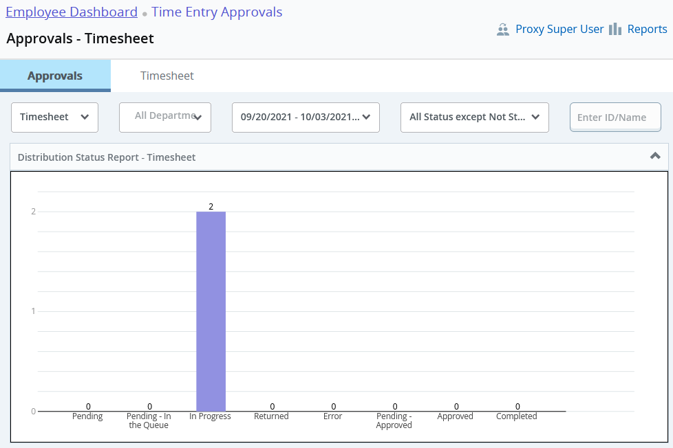
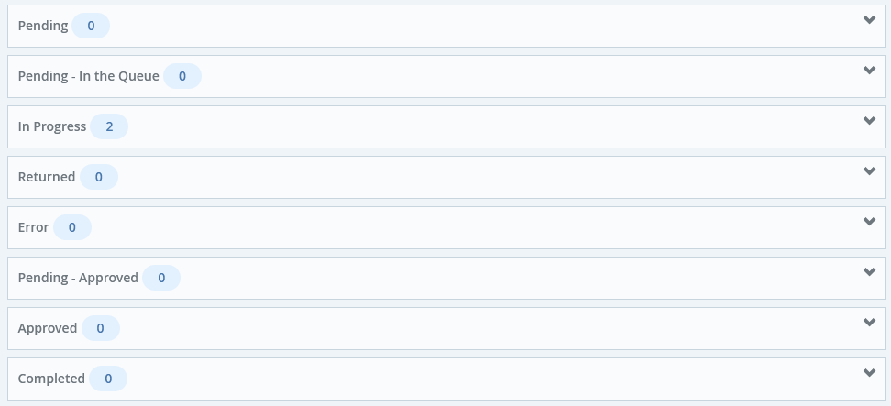
Time Entry Preview & Approvals
You will see a Distribution Report that shows you how many timesheets are in each status (Pending, In Progress, Approved, Complete, etc.) and each employee listed below in each section with drop-down menus.
Click on each employee to preview the timesheet submitted and/or look at leave balances.
Click the drop-down menu (∨) to expand each section & view employees

Slide 6
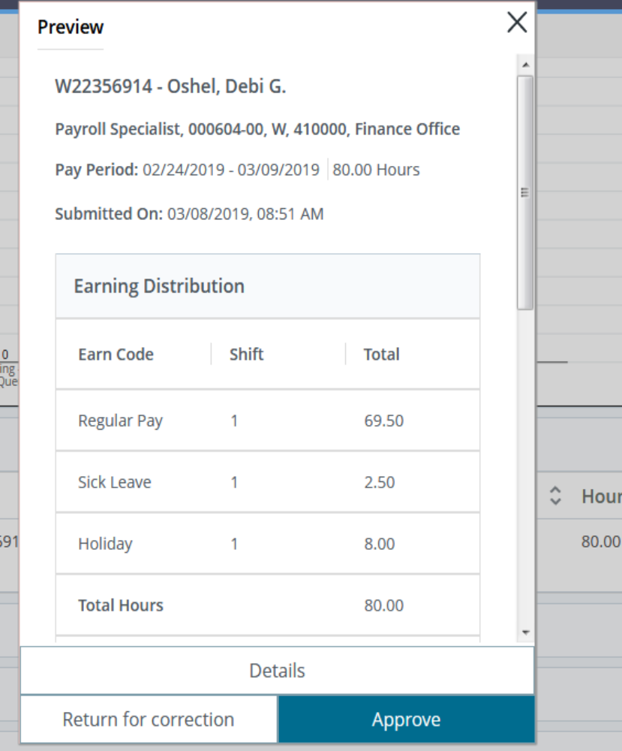
Approve or Return for Correction
(Repeat for Each Employee Timesheet)
Return for Correction
Approve
If the timesheet is incorrect,
click “Return for Correction” & notify the employee
to correct and resubmit for approval.
If the timesheet is correct, click “Approve”.
Details
Click details to review the employee's timesheet.

Slide 7
Recall & Return for Correction
AFTER Approval
Return
Click “Return” to return employee’s timesheet for correction & notify the employee to correct and resubmit for approval.
Recall
Click “Recall” to recall employee's timesheet to approval queue.

Slide 8
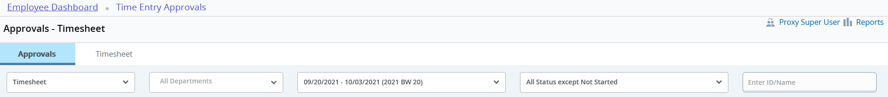
Other Options
Click “Reports” to see a break down for the pay period of hours reported.
Return to Employee Dashboard
Click “Employee Dashboard” to return to the home screen.
Timesheet
Click “Timesheet”, to see your timesheet.
Reports

